Slide 1
COMP 1531
Tutorial 6

Slide 2
Today’s Agenda:
Estimates - Story points (resolving a question from week 3)
Measurements
Cyclomatic Complexity

Slide 3
ESTIMATES - STORY POINTS

Slide 4
Measurements - Story Points
A few weeks ago someone asked “why do we use story points?” and I said I’d usually just use hours
Story points are not directly related to time
The are all completely relative, reading a single user stories points without comparing to the others in the project gives you no indication of how long it will take
They are a measure of effort, if you’re given a story as a basis and award 1 point, giving 2 points to subsequent one’s means you expect it to be twice as hard (no real time estimate)
Time can be anticipated as you make your way through iterations of a project and see how long points seem to take to complete

Slide 5
Planning poker rules:
Each estimator is holding a deck of Planning Poker cards with values like 0, 1, 2, 3, 5, 8, 13, 20, 40 and 100, which is the sequence we recommend. The values represent the number of story points, ideal days, or other units in which the team estimates.
The estimators discuss the feature, asking questions of the product owner as needed. When the feature has been fully discussed, each estimator privately selects one card to represent his or her estimate. All cards are then revealed at the same time.
If all estimators selected the same value, that becomes the estimate. If not, the estimators discuss their estimates. The high and low estimators should especially share their reasons. After further discussion, each estimator reselects an estimate card, and all cards are again revealed at the same time.
The poker planning process is repeated until consensus is achieved or until the estimators decide that agile estimating and planning of a particular item needs to be deferred until additional information can be acquired.

Slide 6
GROUP EXERCISE: Story Estimates with Planning Poker
The following user stories are from the lecture estimation exercise.
In groups of 4 or 5 (different to your project teams), use planning poker to come up with your own point estimates for each story.
Like in the lecture, the first story has been given an initial point value to act as a baseline.
Unlike in the lecture, you should do this one story at a time.
Don't progress to the next story till you've all agreed on an estimate for the current story.

Slide 7
As a company, I want to post job openings so that suitable candidates can find them.
Story Points: 5

Slide 8
As a jobseeker, I want to search for jobs by attributes like location, salary range, job title, company name, and the date the job was posted, so that I can find jobs which meet my basic criteria
Story Points: 12

Slide 9
As a jobseeker, I want to view information about each job that is matched by a search, so that I can make an informed decision whether I want to apply
Story Points: 3

Slide 10
As a jobseeker I want to view detailed information about a company that has posted a job, so that I can determine if it is somewhere I want to work
Story Points: 5

Slide 11
As a jobseeker, I want to put in an applications for jobs I'm interested in, so that I can make companies aware of my suitability for a job
Story Points: 10

Slide 12
Discussion:
Once done, as a class, discuss the following questions:
How close were your initial estimates?
How many rounds did it take for them to converge?
Did the number of rounds decrease as you estimated more stories?

Slide 13
MEASUREMENTS

Slide 14
Discuss the following project-related measures and answer the questions below:
Are their scales nominal, ordinal, interval, ratio, or absolute?
What meaning can we infer from them?
Do they have a value or range that makes an appropriate target?
What are the results of applying them to your project?

Slide 15
Scales refresher (1 of 2):
Nominal: group subjects into different categories
Mutually exclusive, jointly exhaustive
E.G. sunny, cloudy, windy, rainy
Ordinal scale: subjects can be compared in order
Asymmetry, transitivity
E.G. “Bad”, “Good”, “Excellent”
Interval scale: exact differences between measurement points - choice of a unit ‘0’ is arbitrary/nonsense
E.G. Degrees celsius - 30deg is 10deg hotter than 20deg

Slide 16
Scales refresher (2 of 2):
Ratio: has absolute zero, which means there is none of whatever you are trying to measure. The presence of a true ‘zero’ value means you can say “something is twice as ___ as something else” and it actually makes sense.
E.G. centimetres, 0 = no distance to measure
4cm is 2 times longer than 2cm
Why weather isn’t: if it’s 0 degrees celsius, what degree is twice as cold? Mathematically 0 * 2 = still zero but the weather would be very different
Absolute: only one way to measure a property
E.G. How many chairs can fit in this room?

Slide 17
Discuss the following project-related measures and answer the questions below:
Are their scales nominal, ordinal, interval, ratio, or absolute?
What meaning can we infer from them?
Do they have a value or range that makes an appropriate target?
What are the results of applying them to your project?

Slide 18
The bus factor: the minimum number of people that would need to be hit by a bus for a project to fail.
Group intercommunication: How many possible channels of communication there are between n team members. Defined as n(n − 1) / 2, or the number of edges in the complete graph with n nodes.
Lines of Code: The number of lines of code (usually not including comments) in a codebase.

Slide 19
The bus factor: the minimum number of people that would need to be hit by a bus for a project to fail.
Interval scale. Differences between 2 measurements carries some form of meaning. Doesn’t make sense to have a zero point as a project with a bus factor of zero cannot go ahead/makes no sense, but results can be compared and the difference between them has meaning.
A low bus factor would be bad for a project. If a project only requires one person to leave before it fails then there is too great dependency on one or more individuals.
This can depend on a number of factors, most obviously the size of the team. It's a worthwhile thing to consider though.
Ideally this should be strictly greater than 1.

Slide 20
Group intercommunication: How many possible channels of communication there are between n team members. Defined as n(n − 1) / 2 (= the number of edges in the complete graph with n nodes).
Interval scale. There is no zero point as it’s not really a team if you’ve never communicated ever. Also, if one team has 4 channels, you can’t compare anything meaningful to a team with 2 channels, because the number of members is also different => the ratio of the measure has no meaning.
A high number of channels increases the chance of miscommunication. This is why large teams can be less effective than smaller teams and why adding more people to an existing team can slow them down as the new people need to be brought up to speed.
As it based entirely on team size, it would be more appropriate to set a max team size.
Should be 6 or 10 for teams of 4 or 5.

Slide 21
Lines of Code: The number of lines of code in a codebase.
Arguably an absolute measure, if you can only count the lines. If you choose to ignore certain lines (blank, comments, etc.) then it's a ratio measure, i.e. you can compare results of 5000 lines of executable python instructions to 10 lines of python.
Roughly correlates to project complexity. However, the results tend not to be comparable. For example, C tends to have more lines of code than python for the same program.
No, at least not when used for a whole project. A maximum number of lines changed per commit can be a useful target though.
Can find out with wc -l *.py, but this includes comments and blank lines.

Slide 22
Cyclomatic Complexity

Slide 23
What Is Cyclomatic Complexity:
A measure of branch complexity in your functions:
To compute:
Convert function into a graph
Calculate the value of the formula:
V (G) = e − n + 2
where e is the number of edges and n is the number of nodes

Slide 24
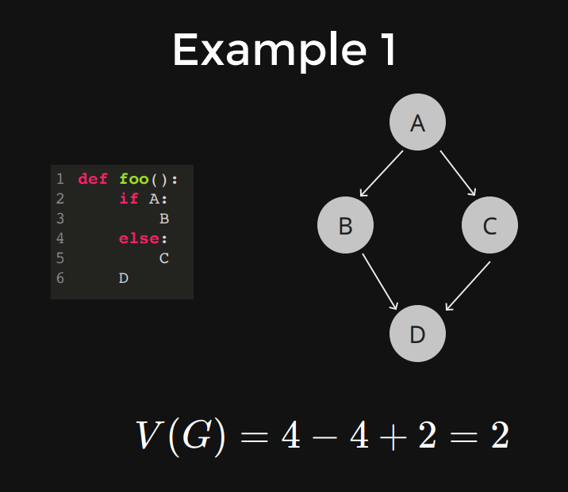
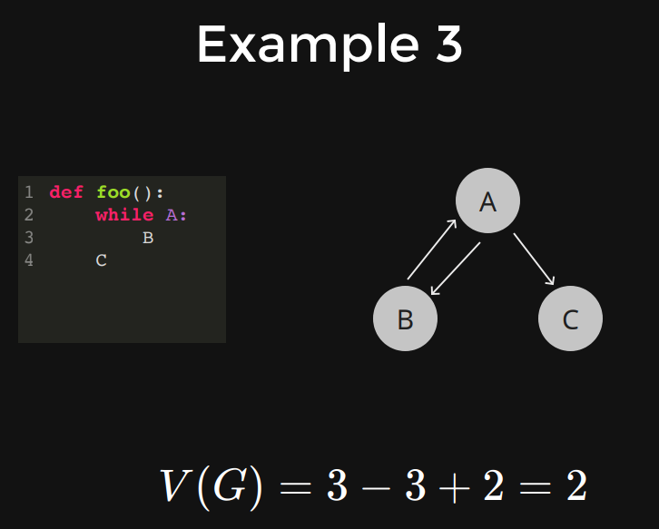

Slide 25
Calculate Cyclomatic Complexity for: (#1)
def foo():
if A:
if B:
C
else:
D
E
Calculation: method
A->B->C->E => (A, B), (B, C), (C, E)
A->E => (A, E)
A->B->D->E => (A, B), (B, D), (D, E)
6 edges
5 nodes
6 - 5 + 2 = 3, complexity = 3

Slide 26
Calculate Cyclomatic Complexity for: (#2)
def bar():
while A:
B
if C:
D
E
Calculation: answer hidden 3

Slide 27
Calculate Cyclomatic Complexity for: (#3)
def baz():
if A:
if B:
if C:
D
E
Calculation: answer hidden 4

Slide 28
Calculate Cyclomatic Complexity for: (#4)
def is_prime(n):
if n <= 1:
prime = False
elif n <= 3:
prime = True
elif n % 2 == 0 or n % 3 == 0:
prime = False
else:
prime = True
i = 5
while i*i <= n and prime:
if n % i == 0 or n % (i + 2) == 0:
prime = False
i += 6
return prime
Calculation: answer hidden 6

